Slide 1
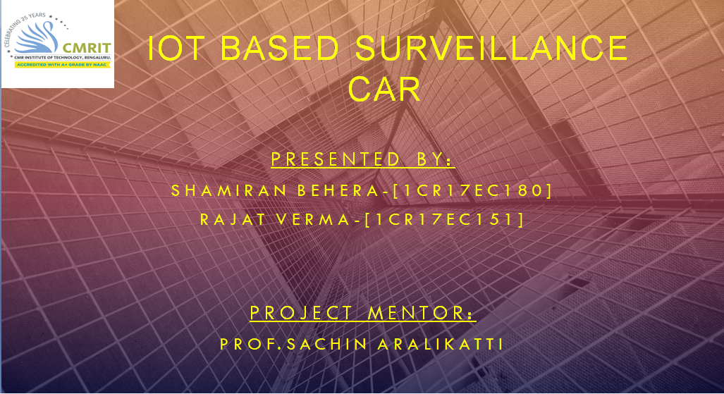
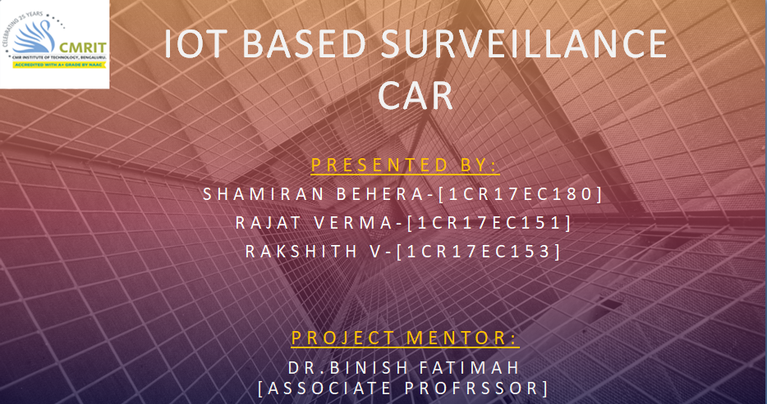
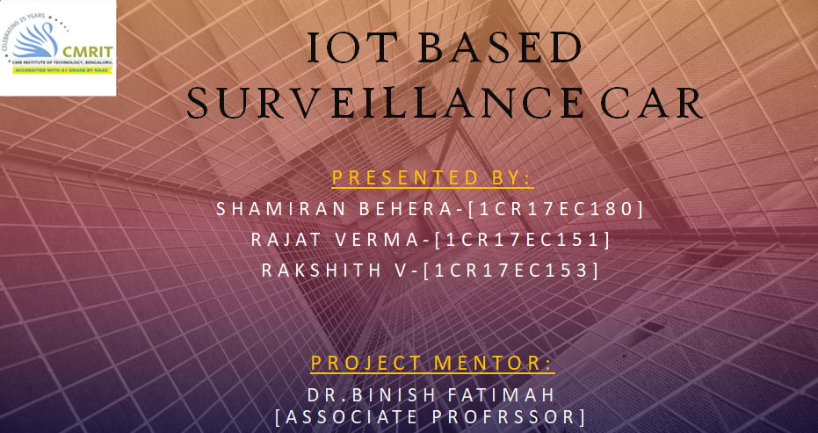

Slide 2

Acknowledgment
Firstly we would like to thanks our madam for her invaluable Guidance in our topic. She took interest in checking all minute bugs in our project report and guided us throughout the project.
Our deepest and most sincere feeling of gratitude to our Section in-charge who has kindly allowed us to work on this topic and for his valuable guideline to us.
We also want to thank our classmates for their motivation. Finally we would like to express our cordially thanks to all of those who helped us directly or indirectly in this project work. We dedicate our project to the institution of our life that is our parents.

Slide 3
Description
Video surveillance is the process of monitoring a situation, an area or a person. This generally occurs in a military scenario where surveillance of borderlines and enemy territory is essential to a country’s safety. Human surveillance is achieved by deploying personnel near sensitive areas in order to constantly monitor for changes. But humans do have their limitations, and deployment in inaccessible places is not always possible.
There are also added risks of losing personnel in the event of getting caught by the enemy. With advances in technology over the years, it is possible to remotely monitor areas of importance by using robots in place of humans.
We have developed a robot which can be used for video surveillance & monitoring which can be controlled through a GUI interface. The control mechanism is provided with a video transmission facility. The video transmission is practically achieved through high-speed image transmission. Initially, the robot will be equipped with a camera which will capture the scenes and transfer the images to the server on which the user will be controlling and watching the live feed.

Slide 4
Block Diagram
GEAR MOTORS
MOTOR DRIVER
NODE MCU
ESP-8266
SMART PHONE
BLYNK APP
CLOUD

Slide 5

BILLS OF MATERIALS
Control Board NODE MCU ESP- 8266
WHEELS
Motor Driver IC (L298N)
Motor (12V-200RPM)
Battery (12V-1.2A)
JUMPERS

Slide 6
WORKING
Prototype consists of a camera module, voltage regulator circuitry with L298N motor driver and NODE MCU. The real time video is displayed on the display which can be viewed from anywhere in the world using internet or within the Wi-Fi range and one can control it using those control provided.
Step 1: Setting up the NODE MCU and installation of ARDUINO IDE SOFTWARE from ardiuno.com Here we used BLYNK APP.

Slide 7
WORKING
Step 2: Write the controlling of the robot code based on the L298N IC logic we have used.
Step 3: Connect a Wi-Fi to connect NODE MCU with Wi-Fi router. When it is connected with Wi-Fi router, IP Address can be found using ifconfig command.
Step 4: Once we got the IP address we can use it for controlling purpose.

Slide 8
WORKING
Step 6: Now build the Robotic unit, we can use DC Motor based simple robot. To control your motors we need L293D IC. Here we used L293D ICs for controlling two motors.
Step 7: Connection of power Supply. Here we used 12v rechargeable battery for driving the motors. But as per specifications Pi will work on 5 V, So we use IC 7805 for this and also an external portable battery bank can be used directly. We connect battery terminals directly to motor driver IC.
Step 8: Now sitting in your room you can control the robot anywhere in the world.

Slide 9
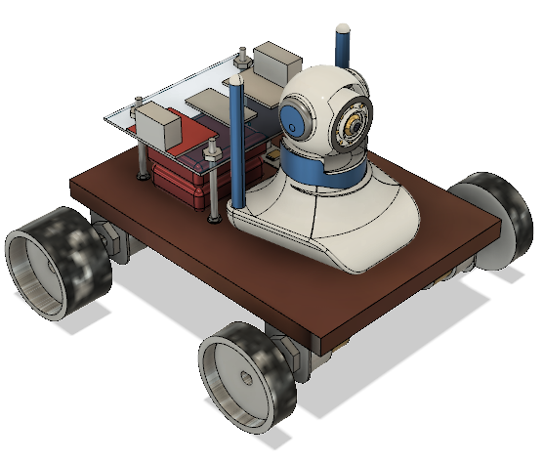
MECHANICAL STRUCTURE
ISOMETRIC VIEW

Slide 10
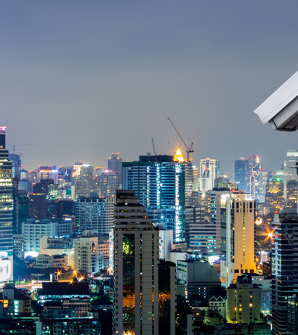
ADVANTAGES
Video surveillance is the process of monitoring a situation, an area or a person.
This generally occurs in a military scenario where surveillance of borderlines and enemy territory is essential to a country’s safety.
There are also added risks of losing personnel in the event of getting caught by the enemy.
It can sense object by IR sensor .
Camera is live time watching facility .
remotely monitor areas of importance by using robots in place of humans.
The video transmission is practically achieved through high-speed image transmission.

Slide 11

DISADVANTAGES
This robot can not go through a pipe of lesser diameter.
The source of the robot is battery therefore the battery is on maintenance always.
Its not a water proof or fire proof.
It can’t run without the wifi or access to internet.

Slide 12
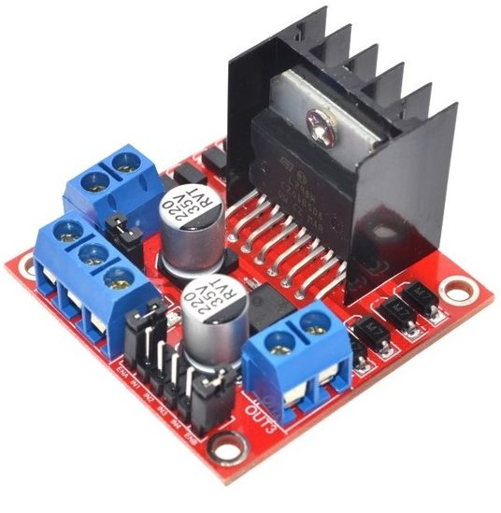
MODULE-1
MOTOR DRIVER CIRCUIT

Slide 13
MODULE-1
The L298N H-bridge module can be used with motors which have a voltage range of between 5 and 35V DC. With the help of L298N H-bridge module, it is quite easy to control one or two DC motors. First, connect each motor to the A and B connections on the L298N module. Ensure that the polarity of the motors is the same on both inputs if you are using two motors for a robot or anything. Otherwise, you may need to exchange them over when both motors are set to forward and one goes backward. Next, connect the power supply to pin number 4 on the L298N module and negative/GND to pin number 5 of the L298N module.

Slide 14
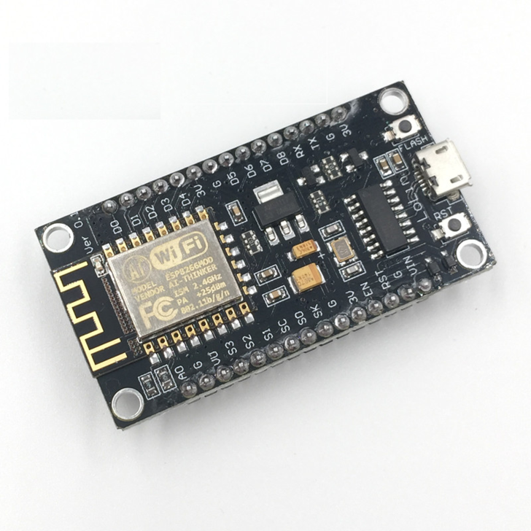
MODULE-2
WIFI MODULE ESP-8266

Slide 15
MODULE-2
CONTROLLER – [ESP-8266]
ESP8266 module, which can then connect to it either using with your smart phone or computer device. Then you can configure the WiFi connection and connect it to your local WiFi network using the web interface.
Through which can use it for video surveillance & monitoring which can be controlled GUI interface

Slide 16
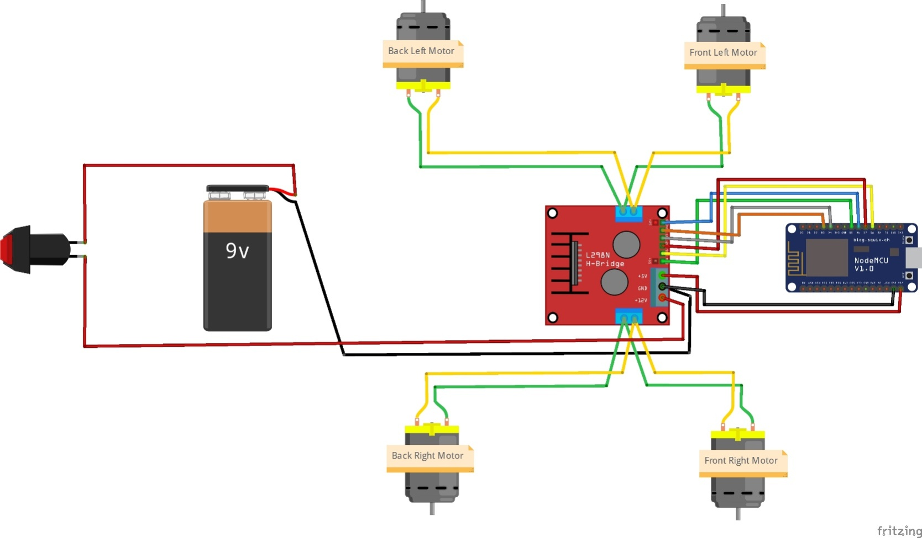
CIRCUIT

Slide 17
PROGRAM

Slide 18
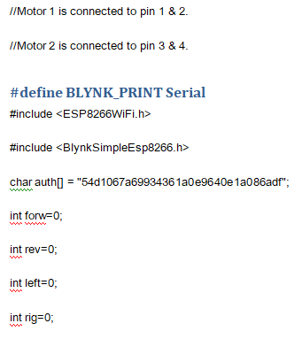

Slide 19
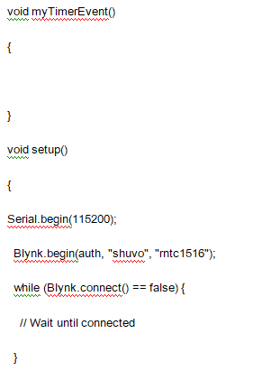

Slide 20
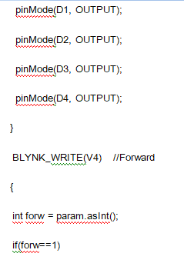

Slide 21
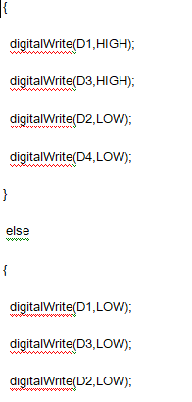

Slide 22
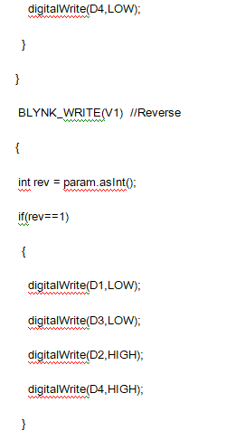

Slide 23
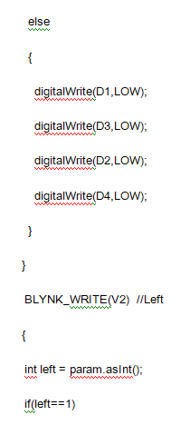

Slide 24
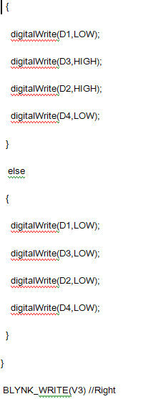

Slide 25
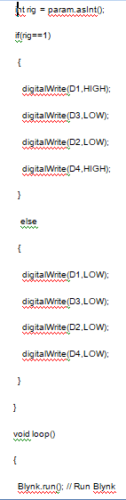

Slide 26
ADVANTAGES V/S LIMITATIONS
ADVANTAGES
LIMITATIONS
Wi-Fi based wireless broadband services could be used for public surveillance systems (Surveillance of a locality, street, traffic junctions, etc).
Wireless surveillance cameras can be useful in situations where it is difficult to lay cables – Museums, Heritage buildings, Industrial plants, etc.
Wireless surveillance system is cost effective (when compared to wired networks involving Fibre Cables, Trenching, etc) to install and maintain.
Wireless Networks can be deployed quickly and wireless surveillance can be used for providing temporary Wi-Fi to fairs/ exhibitions, etc.
Wireless Point-to-Point back-haul networks could extend the network to more than 5 KM over the wireless medium, if required.
If the wireless network is not properly configured, there would be interference from access points operating in the same channel (From internal and neighboring AP’s) which would reduce the quality of the Wi-Fi network.
The most commonly used Wi-Fi network band – 2.4 Ghz has only three non-overlapping channels and is always over-crowded. Besides, non Wi-Fi devices like Microwave Owens, Bluetooth devices, etc can interfere with Wireless networks.
For long-haul backbone wireless networks, Line of Sight might be required. Even for WiFi access networks (that don’t require a Line of Sight), the signal strength and signal quality might be affected due to interfering objects like Glass, Trees, Elevators, Metallic Racks, etc.

Slide 27
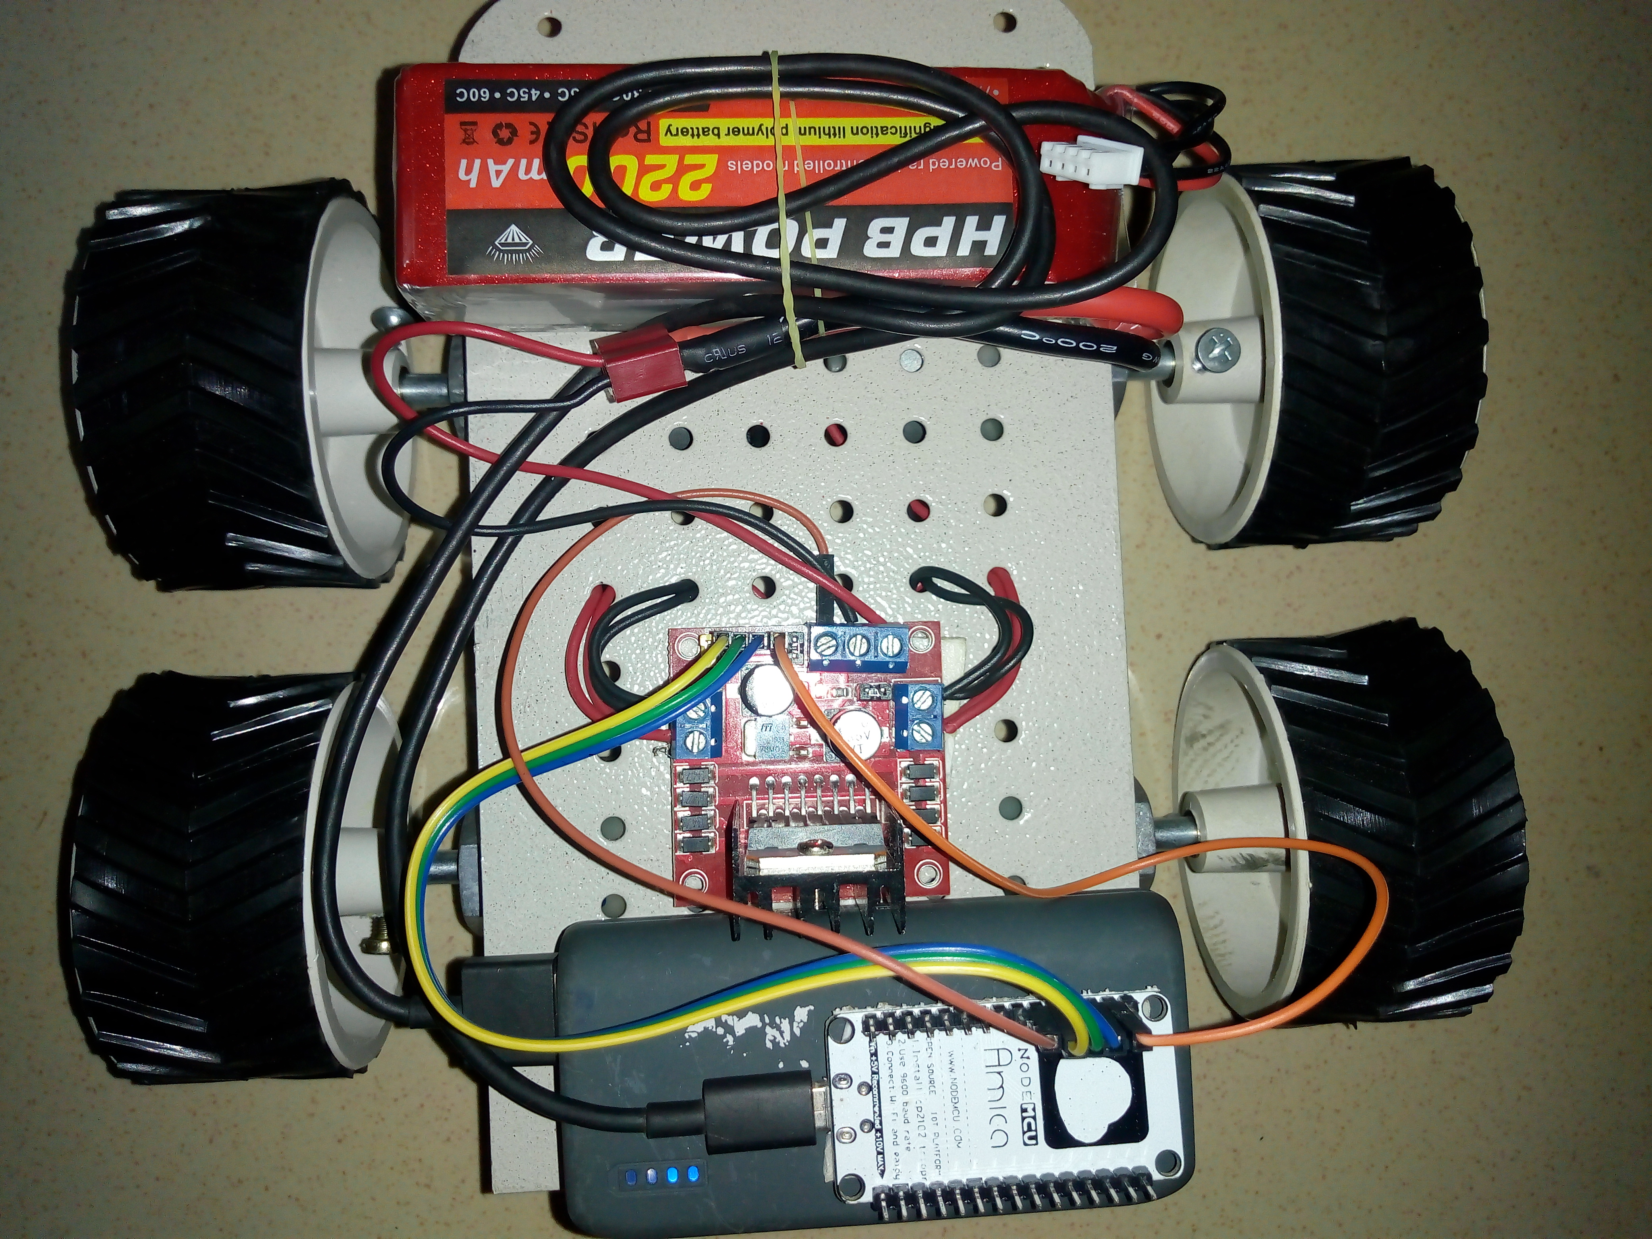
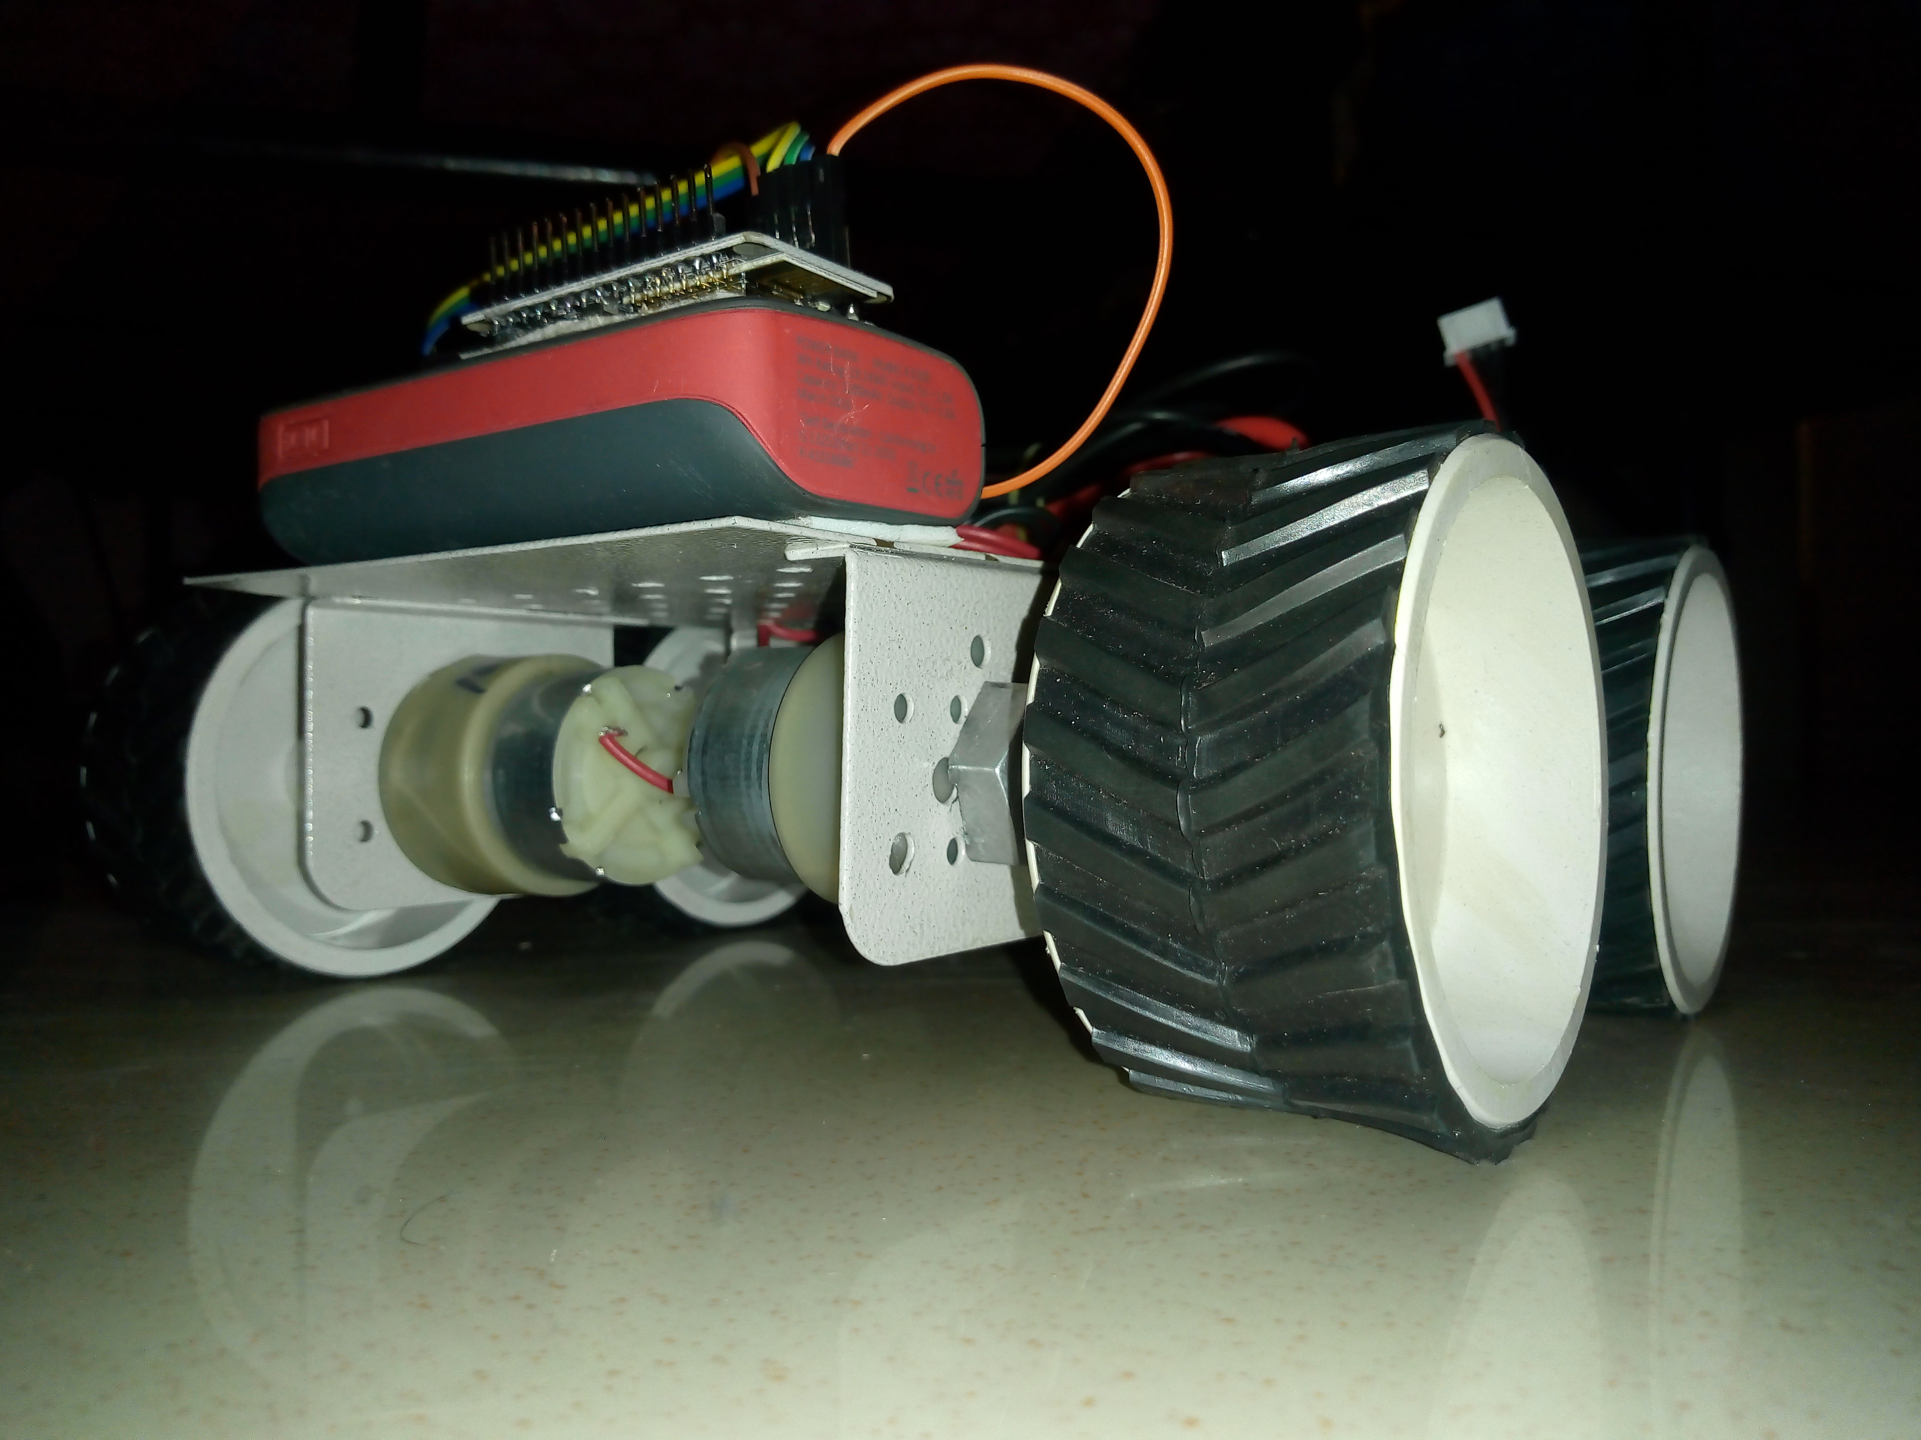
THE WORKING MODEL OF IOT BASED SURVEILLANCE CAR

Slide 28

APPLICATIONS
. Indoor spying of warehouse, campus surveillance to check the improper activities.
2. Tracking locations of terrorist organizations and then plan an attack at a suitable time.
3. Making video surveillance of any disaster affected area where human beings can’t go.
4. Field view surveillance of indoor & outdoor commercial complex, factories & government buildings/organization.

Slide 29

FUTURE SCOPE
There are lots of improvements that can be made on the current design and technology and lots of additional feature scan be added. We can use different types of sensor so that we can use robot in different field i.e. Temperature Sensor, Pressure Sensor, Heat Sensor, Position Sensor, Proximity Sensor. A multipurpose robot can be made by wireless network, ranging from surveillance and home security to industrial applications where the user need not be present at the work place in person but can do it from his home itself.

Slide 30

CONCLUSION
. The robot will be equipped with a camera which will capture the scenes and transfer the images to the server on which the user will be controlling and watching the live feed.
Video surveillance is the process of monitoring a situation, an area or a person. This generally occurs in a military scenario where surveillance of borderlines and enemy territory is essential to a country’s safety.

Slide 31

Large Picture Slide
THANK YOU
I STAND ON MY SKILLS

